Slide 1
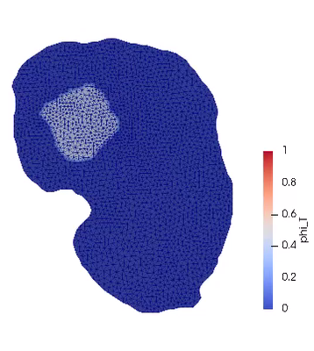
The model used in the file is a
simple reaction diffusion model with logistic tumor growth
The objective function is:
No tumor flux across
the kidney boundary,
i.e.,
TO DO:
1. Install adjoint_dolphin and run the example code (RD_optimization_tumor_v3_validation.py).
2. Change the function “forward” to the elasticity-coupled model.
3. Change the function “objective” to the AIC measure.

